Slide 1


Thame Swimming Club
Annual General Meeting
3rd July 2024

Slide 2
Agenda
Welcome
Chair’s Update
Treasurer’s Report
Committee member’s reports
Head Coach’s Report
Election of Committee
Questions and Feedback

Slide 3
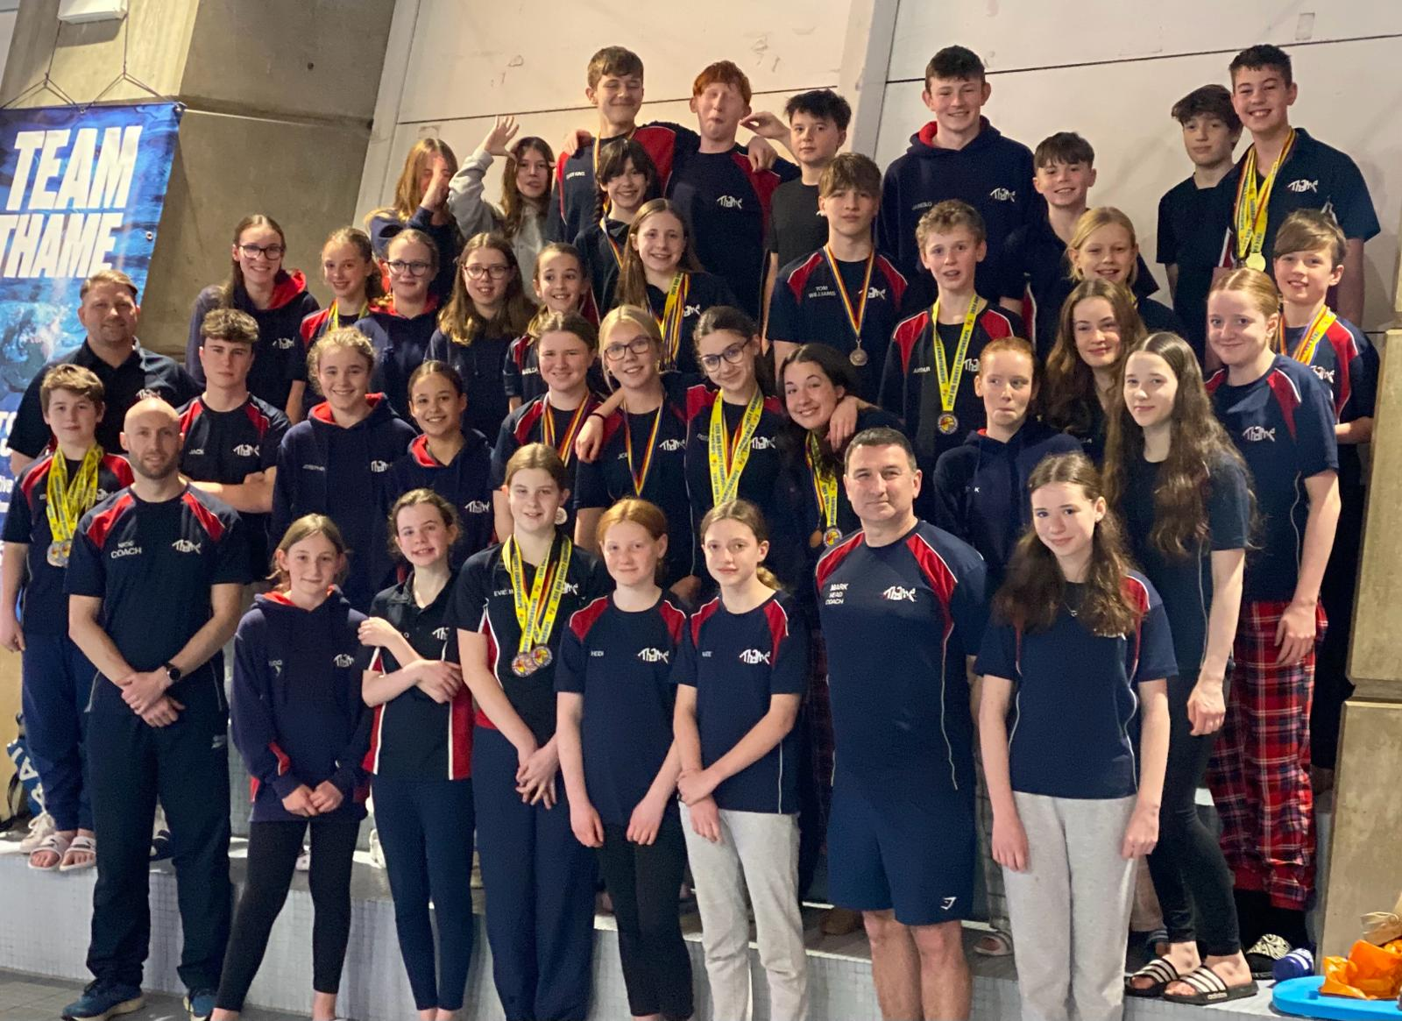
Chair’s Update

Slide 4
Our Vision
To inspire each and every swimmer to reach their full potential within a supportive, fun and collaborative environment

Slide 5
Why do we do this?
“Thank you so much again for everything. It is a fabulous club”
“It is a great community asset”
“A big thank you to all at Thame Swimming Club, for giving XXX the opportunity to swim for them. It's been a big part of her life (and ours) for the last few years and we will all miss it.”
“Thank all of the coaches and those involved in the club for having championed XXX over the last few years, and for instilling a love of swimming within XXX - it means a lot.”
“XXX has really enjoyed being with the club and we hope that friendships that he has made over his time will continue.”

Slide 6
Last year
Thame Swimming Club is going from strength to strength with Thame coming 8th with 320.5 points (best total and highest placing ever) in 2024 County Championships
5 swimmers get to the South-East regional championships with 2 getting into the finals.
Change in Chair and Head Coach/ Assistant Head Coach
Growing number of swimmers
Successful recruitment of new coaches and volunteer
Swimmers invited on county development programs
Strong financial position

Slide 7
Year ahead
Continuous demand for trials and swimmers wanting to join
Swimmers continuing to reach their potential whilst having fun
To increase the number of swimmers who represent Thame at Counties and Regionals
Successfully retain and recruit coaches and committee to ensure stability
More coaches to complete Level 2 coaching course
Ensure a robust parent volunteer program is in place to sustain the long-term viability of the club
Ensure the long-term financial viability of the Club
Swim camp October 2024- with 35 swimmers to go.

Slide 8
Treasurer’s Report

Slide 9
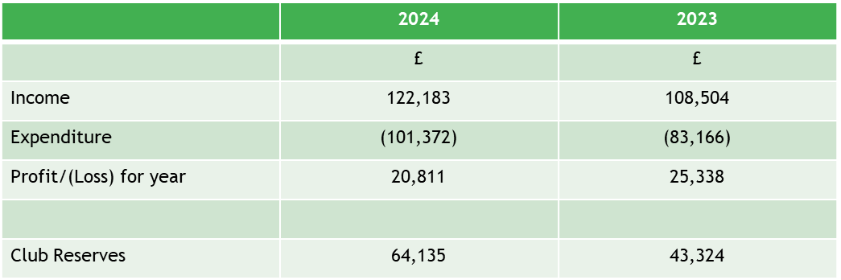
Thame Swimming Club
Finance update
Year ended 31 March 2024

Slide 10
Finance Update
Large profit this year. We have had 2 years of Head Coach not being paid.
Continued to build up strong reserves of £64k
Going forward in 24/25, the Head Coach is now paid and pool costs have increased.
The large reserves will be used to allow the club to continue without large membership fee increases
Going Forward
Continue to invest in club equipment- agreed annual allowance £3k
Continue to invest in coaches’ development

Slide 11
Committee Member’s Reports

Slide 12
Membership and Trials
The Club is currently standing at 109 swimming members made up across the following groups:
      Fundamentals 6
      Group 1 21
      Group 2 19
      Group 2+ 17
      Group 3 27
      Group 4 19
      Progression through the groups is encouraged and at the most recent update, 21 swimmers were offered places in higher groups.
      We have taken on 29 members in the last year. Trials are held every quarter, from Sept 2023 - June 2024 we have received over 35 requests for trials. The next trial is due to be held on 11th July 2024.

Slide 13
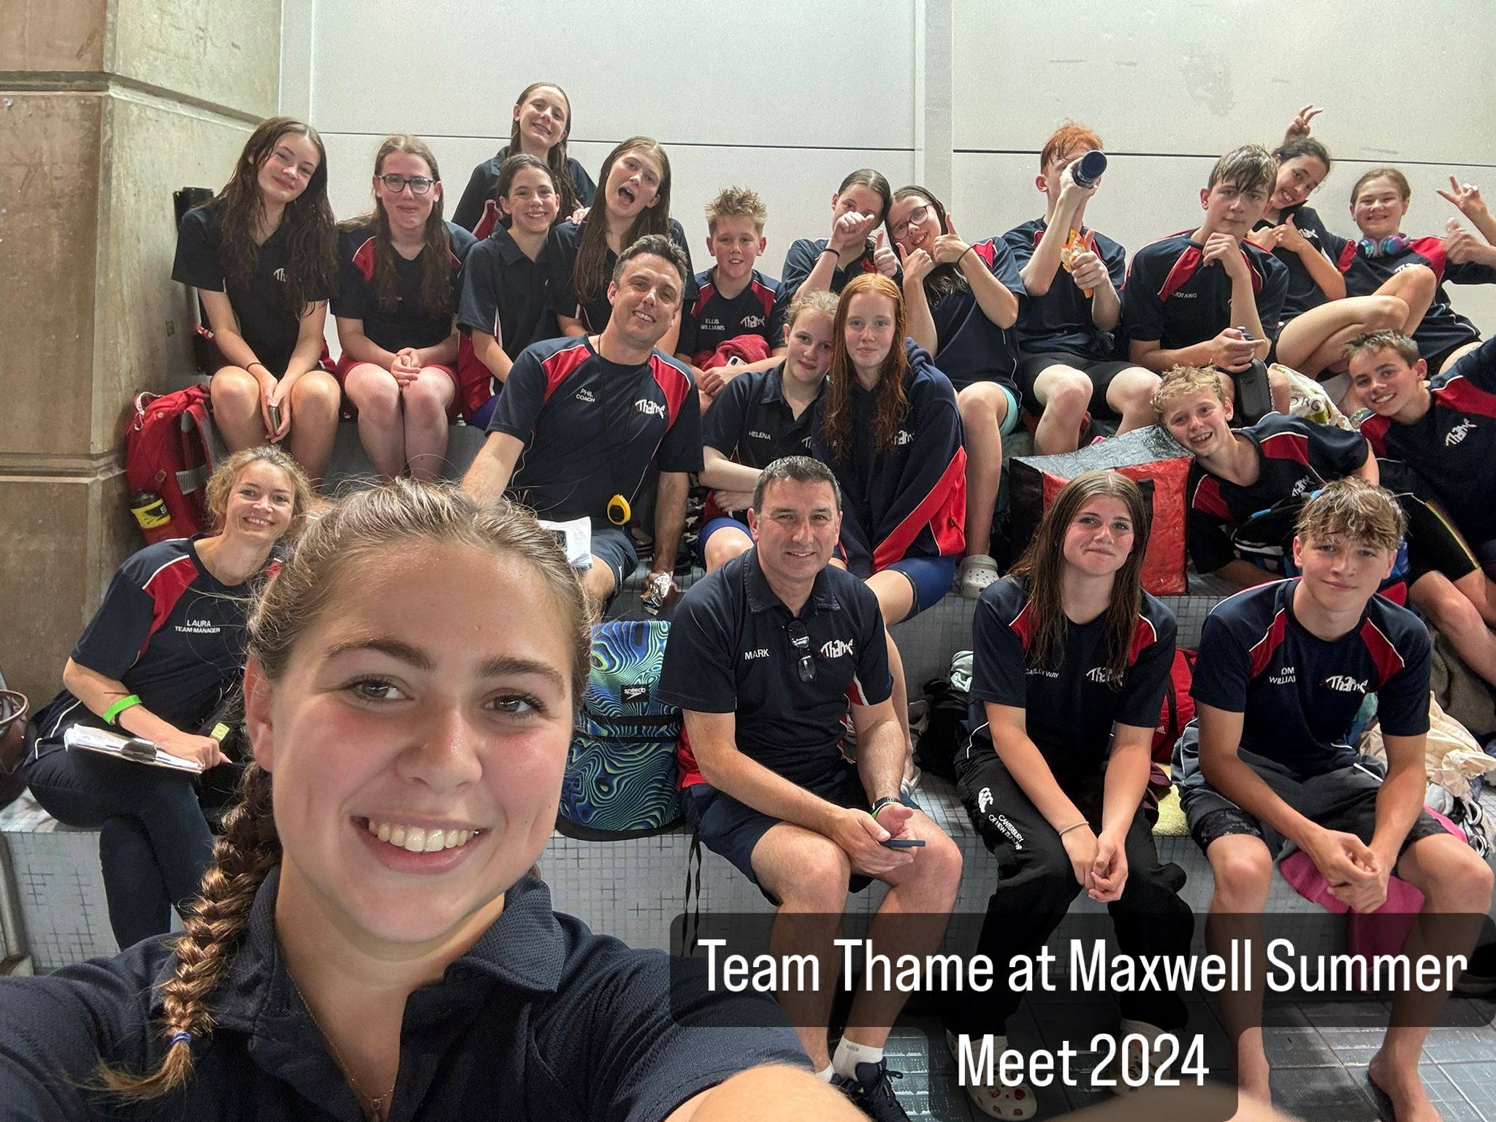
Galas
Thame Swimming Club has participated
in over 20 galas over the last year,
including our own Club Championships
in September 2023 in which almost all
our swimmers (100 in total) took part.
An amazing 51 swimmers qualified to
compete in the Oxforshire and North
Buckinghamshire County Champies in
January & February of this year with a further 4 going on to compete in the Regional South East Championships in March 2024.
We are now looking ahead to another busy year, kicking of with Club Champs on 14/15 September 2024.

Slide 14
Volunteer and Officials
HUGE THANKS TO OUR AMAZING VOLUNTEERS!
A massive shout out to all our fantastic volunteers who have given their time and effort over the past year. To our Team Managers (TMs), Timekeepers and Officials your work has been incredible, and we could not have done it without you. THANK YOU!
WE NEED MORE VOLUNTEERS!
To keep our swimmers competing and our club thriving we urgently need more parents to volunteer – particularly as Officials. Without your help, our ability to participate in galas and maintain our competitive spirit is at risk.

Slide 15
Volunteer and Officials
CURRENT VOLUNTEER SITUATION
  Officials:
    4 x J1 Officials in Training
    9 x J1 Officals
    BUT, 3 Officials are leaving soon and 1 J1 Official is also our Head Coach! This leaves us with only 9 Officials for a club with 109 swimmers!
  Team Managers:
    16 Team Managers with 1 in Training
    BUT 2 Team Managers will be leaving soon.
    It is also worth noting that quite a few of our volunteers are both TMs and Officials – they can only be in one place at a time!

Slide 16
Volunteer and Officials
WE NEED YOUR HELP!
Please consider volunteering to help us keep the club running smoothly and our swimmers in the pool. Every bit of help makes an enormous difference.
For more info or to sign up contact Jo Sackett:
volunteers@thameswimmingclub.co.uk
Thank you so much for your support.

Slide 17
Welfare
Since the last AGM there have been significant policy changes to Wavepower and the publication of the heart of Aquatics Listening report.
Alongside Health & Safety and TSC Policy Lead, all Codes of Conduct have been updated inline with the new Wavepower.
The Child Protection policy is being expanded to include vulnerable adults.
Swim England has introduced a new aquatic specific safeguarding training for all volunteers from Jan 2024. All required DBS and safeguarding training are up to date within the club.
TSC has produced an inclusion plan and members of the committee and coaching team have undertaken some training in this area as well.
A 2nd Welfare Post has been created, with website updated to include a Welfare section and a TSC Welfare email address has been set up.

Slide 18
Policies and Swimark
This year we have :
Created a Conflict of Interest register for committee members for transparency
Introduced a Feedback, Concerns and Complaints section to our website and outlined a clear Complaints process
Set up a governance e mail address in case any governance or complaints issues need to be addressed separately to avoid conflicts of interest.
Created a Swimmer Behaviour Policy and clear disciplinary process and Behaviour Contract in case of specific concerns requiring management.
Created a Code of Conduct for over 18s
Applied for our SwimMark Health Check to keep our accreditation.

Slide 19
Fundraising
There have been a number of fundraising events across the year. These have included those supported by Thame Rotary Club; Santa’s Sleigh, the Duck Race and the Swimathon.
The major source of fundraising for 2023 was for Swim Camp and came from the mini triathlon - hosted at Thame Leisure Centre. Another triathlon to raise funds for this year’s 2024 swim camp is scheduled for 14th July 2024.
Club Championships raised revenue through race entry costs, sponsorship of races and the sale of drinks and snack at the event. £150 of race sponsorship has been secured from local businesses for the next Club Championships (Sept 2024) and also raffle prizes for which tickets will be sold at Club Champs.
We do not currently have any club sponsors. Way Builders have kindly sponsored the club in previous years. If your business is interested in sponsoring the club please speak to a member of the Committee.

Slide 20
Head Coach’s Report

Slide 21
Election of Committee

Slide 22
Election of Committee 2024-2025
Role | Proposed
Chair | Alex Dodd
Vice Chair | Paul Gration
Club Secretary | Richard Davies
Treasurer | Ruth Reed
Membership Secretary | Charlotte Clark
Head Coach | Caroline Crosby
Galas Secretary | Beverley Robertson
Communications | VACANT
Health & Safety Officer | Ginevra Sproat
Welfare Officers ( not for voting on at AGM) | Helen Burton and Jacqueline Makris
Policies & SwimMark | Marigold Peters
Fundraising & Sponsorship | VACANT

Slide 23
Questions & Feedback

